Slide 1

Identify root components of website below

Slide 2

Root div
- Height: 100vh
content
nav
Flex: 0
header
Flex: 0
Flex: 1

Slide 3
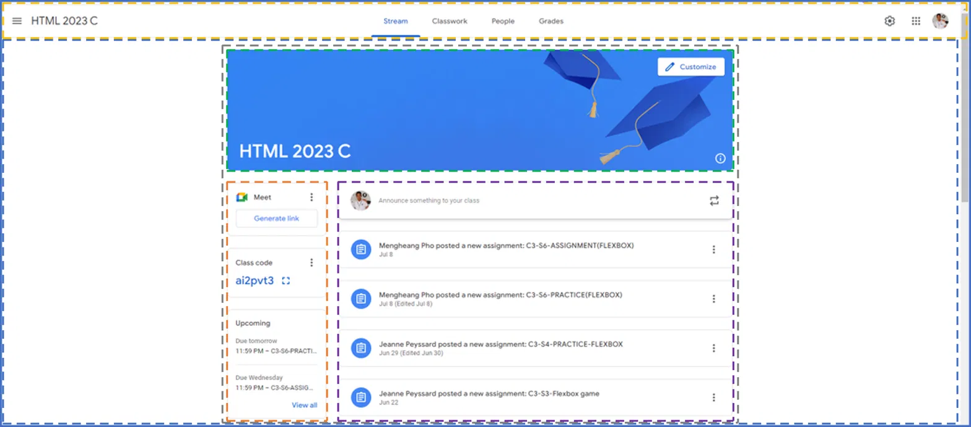
nav (Flex: 0): row, space-between
content (Flex: 1):column, align-items :scenter
nav left
nav center
nav right
page-container: column
banner (Flex: 0)
main : row, flex:1
sizebar: (column, flex:0 )
feed (Flex: 1)
Root (column, 100vh)
nav ( row, space-between)
nav-left
nav-right
nav -center
content(column, flex:1)
page-container(column)
banner
main ( row, flex:1)
sidebar(column,flex:0)
feed(column,flex:1)
announce box (row)
post list -> post item (row)
announce box
meet card
post list
class code card
post item
upcoming card
post item

